Slide 1


NSF U.S.A. Scholarship
The NSF Scholarship is a prestigious award that provides financial support and valuable opportunities for students pursuing STEM education. Discover more about this life-changing scholarship.

Slide 2
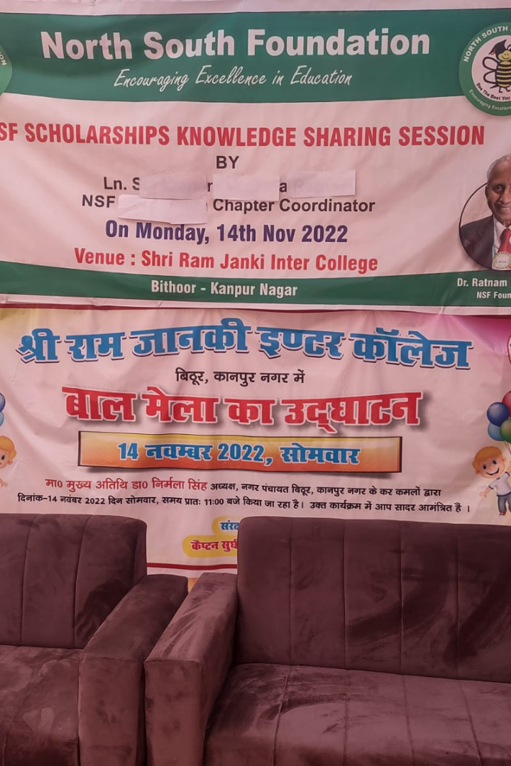
N.S.F. छात्रवृति क्या है ?
The NSF Scholarship is a highly competitive program that aims to support outstanding students in pursuing their studies in Science, Technology, Engineering, and Mathematics (STEM) fields, paving their way towards successful careers.

Slide 3

छात्रवृत्ति का उद्देश्य और लाभ
1
अगली पीढ़ी को सशक्त बनाना
2
वित्तीय सहायता
Recipients receive financial support to cover tuition fees, living expenses, and other educational costs, providing a solid foundation for success.
The NSF Scholarship empowers and encourages the next generation of scientists, engineers, and innovators to excel in their academic and professional journey.
3
परामर्श और नेटवर्किंग
Students have access to a vast network of mentors and industry professionals, fostering valuable connections and guidance for future opportunities.

Slide 4
पात्रता
राष्ट्रीयता
The NSF Scholarship is open to citizens or permanent residents of the country, promoting local talent and expertise.
शैक्षणिक योग्यता
Applicants must demonstrate strong academic performance, including high grades and achievements in STEM-related subjects.

Slide 5
आवेदन प्रक्रिया
1
Key Dates and Deadlines
Last date for scholarship application is 31st December, 2023.
2
Required Documents
Gather all necessary documents, such as dob, address proff ID PAN card , Bank details academic transcripts, NCC certificate sports certificate , caste certificate ,income certificate recommendation letters, and personal statements, to complete your application.

Slide 6
महत्वपूर्ण बिंदु
1.India Chapter announces scholarships through local media and in schools (Aug).
2.Students send their details and request for an application (Aug-Dec).
3.India Chapter coordinator screens requests and send applications to eligible candidates (Oct-Dec).
4.Applications are completed and mailed by students. Income certificates and mark sheets are part of the application (Aug-Dec).
5.India Chapter Coordinator(ICC) forms a selection panel, reviews applications and shortlists candidates to Interview (Sep-Oct).
6.ICC and selection panel interview candidates. One parent is expected to accompany the student. Bus or train fee is reimbursed to the student (Sep-Oct).
7.ICC sends recommendations to NSF India Coordinator in Hyderabad (Oct-Dec).
8.NSF India Coordinator and US Scholarships team do file review. Sometimes further clarifications are requested before approval (Nov-Feb)
9.The chapter also processes any renewals at t his time since NSF supports the student through the entire course of study (Aug-Oct).
10India Chapter holds an awards ceremony and honors NSF scholarships recipients (Dec-Feb).

Slide 7
चयन प्रक्रिया
1
Evaluation Criteria
A panel of experts reviews applications based on academic performance, leadership potential, extracurricular activities, and commitment to STEM fields.
Interview Process (if applicable)
2
Shortlisted candidates may be invited for an interview to further assess their suitability for the scholarship.

Slide 8
लाभ और अवसर
Financial Support
Networking and Mentorship Opportunities
Recipients receive full or partial financial support, relieving the burden of educational expenses and allowing them to focus on their studies.
Engage with a diverse network of scholars, professionals, and mentors who provide guidance, support, and valuable connections for future career prospects.

Slide 9
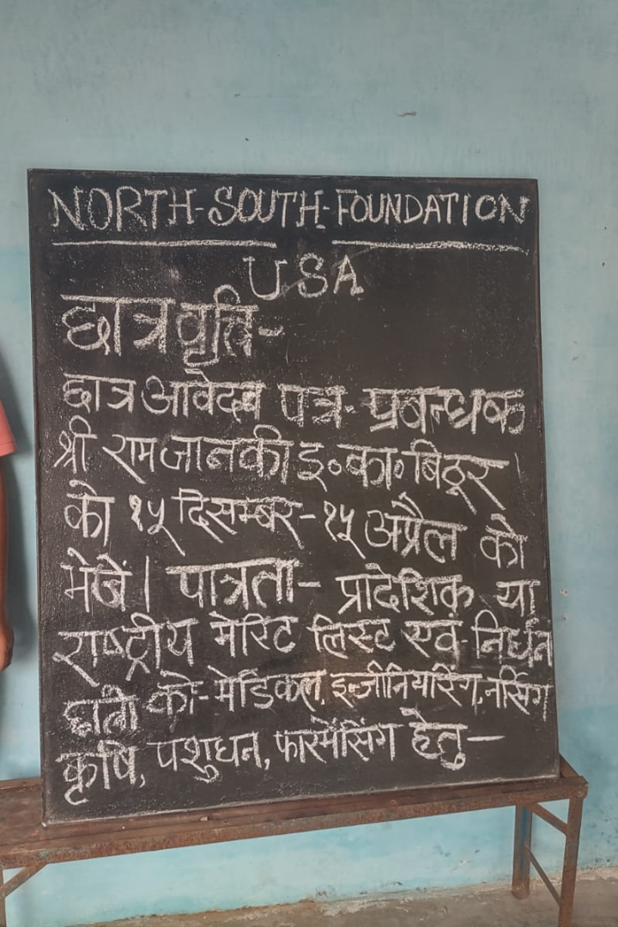
निष्कर्ष
The NSF Scholarship presents an invaluable opportunity for deserving students to pursue their passions in STEM and unlock a world of possibilities. Seize this chance and embark on an extraordinary educational journey!

